Slide 1
Django forms
Dr. Navneet Kaur

Slide 2
Django form
Django provides a Form class which is used to create HTML forms. It describes a form and how it works and appears.

Slide 3
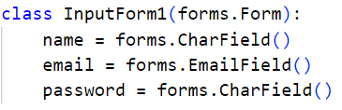
forms.py

Slide 4
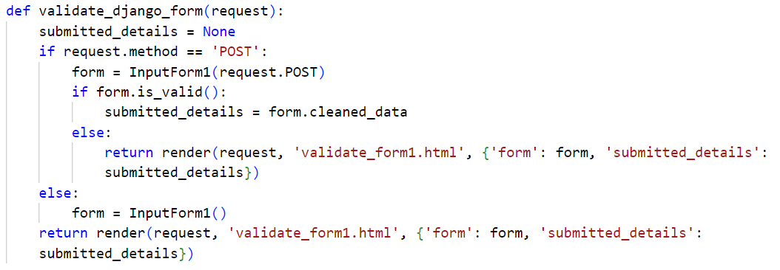
views.py

Slide 5
urls.py

